Slide 1
Proposal Architecture Automation
BOM to Architecture

Slide 2
Objective
Objective of this exercise is to check if based on technical BOM (Synthetic in this case) can architect drawing be drawn in followings
Power Point Slides
Microsoft Visio
AutoCAD Drawing
For your reference BOM & Typical architecture is provided in next slides.

Slide 3
BOM (Synthetic)
Sr. No | Description | Qty | Category | Part Number
PDC ROOM
1 | Analog Monitor Input 225 DSTs | 1 | MON | MON-DPN-001
2 | Analog Control Output 50 DSTs | 1 | GEN | GEN-DPN-002
3 | Discrete Monitor Input 125 DSTs | 1 | MON | MON-DPN-003
4 | Discrete Control Output 75 DSTs | 1 | GEN | GEN-DPN-004
5 | ProfessionalPLUS Premium Workstation Software; 500 DST (does not include dongle or softkey) | 1 | WS | WS-DPN-005
6 | DeltaV System Softkey, for use with ProfessionalPLUS or ProfessionalPLUS Premium base license order | 1 | SWK | SWK-DPN-006
7 | Sytech Reporter | 1 | SW | SW-DPN-007
8 | Redundant PK750 Controller Assembly (includes 2 PK750 Controllers, 1 Carrier, 2 IOPs, and 2 Power Modules) | 1 | CNTR | CNTR-DPN-008
9 | DeltaV Controller Redundancy | 1 | CNTR | CNTR-DPN-009
10 | DeltaV Rack Workstation WITHOUT Tera 2 card; Win10 Ent IoT LTSC 2021; Two 512GB Solid State Drives; RAID 1; 16GB RAM; 5 yr warranty | 1 | WS | WS-DPN-010
11 | Analog Input CHARM; 4-20 mA; HART | 18 | CHARM | CHARM-DPN-011
12 | Analog Input CHARM; RTD/Resistance | 3 | CHARM | CHARM-DPN-012
13 | Analog Output CHARM; 4-20 mA; HART | 49 | CHARM | CHARM-DPN-013
14 | Discrete Input CHARM; 24 Vdc Dry Contact; Low-side Sense | 91 | CHARM | CHARM-DPN-014
15 | Redundant CIOC Carrier with Copper Ethernet, includes CHARM I/O Carrier with Screw Terminals, Copper I/O Ports, a Baseplate Identifier and a Baseplate Separation Wall. CHARM I/O Cards NOT INCLUDED | 1 | CHARM | CHARM-DPN-015
16 | Redundant CIOC2, includes 2 CHARMs I/O Card 2 | 1 | CHARM | CHARM-DPN-016
17 | CHARM Baseplate Assembly with Standard CHARM Terminal Blocks | 31 | CHARM | CHARM-DPN-017
18 | Discrete Output CHARM; 24 Vdc; High-Side | 36 | CHARM | CHARM-DPN-018
19 | DIN-rail Stop for Vertical-Mount Carriers and CHARM Baseplates; Box of 5 | 1 | CHARM | CHARM-DPN-019
20 | Package of Address Plugs 1 through 8 for CHARM Baseplates | 1 | CHARM | CHARM-DPN-020
21 | CHARM Baseplate Terminator, Bottom | 4 | CHARM | CHARM-DPN-021
22 | Channel Identifier Labels for CHARM Baseplates; Package of 8 | 1 | CHARM | CHARM-DPN-022
23 | Relay Output CHARM Terminal Block | 36 | CHARM | CHARM-DPN-023
24 | Discrete Input CHARM; 24 Vdc; Isolated | 1 | CHARM | CHARM-DPN-024
25 | DeltaV Bulk Power Supply 100-240 VAC to 24 VDC, 20A | 1 | PWR | PWR-DPN-025
26 | DeltaV Bulk Power Supply Redundancy Module,12-28V, 20A | 8 | PWR | PWR-DPN-026
27 | Dual Single Mode Media Converter Assembly | 36 | MC | MC-DPN-027
28 | DCS System cum server Cabinet (2100 mm H x 800 mm W x 800 mm D), IP-42,Safe area | 1 | CAB | CAB-DPN-028
29 | DCS Marshalling Cabinet (2100 mm H x 800 mm W x 800 mm D), IP-42,Safe area | 1 | CAB | CAB-DPN-029
30 | DeltaV Smart Switch; 19-inch Rack mount modular model | 1 | SWT | SWT-DPN-030
31 | 19" inch rack mounted sliding screen | 1 | SCR | SCR-DPN-031
32 | APC UPS | 1 | UPS | UPS-DPN-032
33 | FOPP,din mount,SM,6port,LC duplex | 36 | FOPP | FOPP-DPN-033
34 | Fiber optic cable 5 mtr | 8 | FBR | FBR-DPN-034
35 | Hirshman 8 -port rack mount switch | 1 | SWT | SWT-DPN-035
OPERATOR ROOM
36 | DeltaV Full-sized Tower Workstation |  | WS | WS-DPN-036
37 | 24-inch LED Widescreen Monitor |  | MON | MON-DPN-037
38 | DeltaV Live Operations Premium Performance Pack | 1 | GEN | GEN-DPN-038
39 | console for dual screen operator station | 1 | CON | CON-DPN-039
40 | Printer | 1 | PRT | PRT-DPN-040
41 | 6 CORE/3 PORT DUPLEX FOPP - RACK MOUNTED SLIDING LIU | 1 | FOPP | FOPP-DPN-041
42 | Emerson NextGen Smart Firewall | 1 | FW | FW-DPN-042

Slide 4
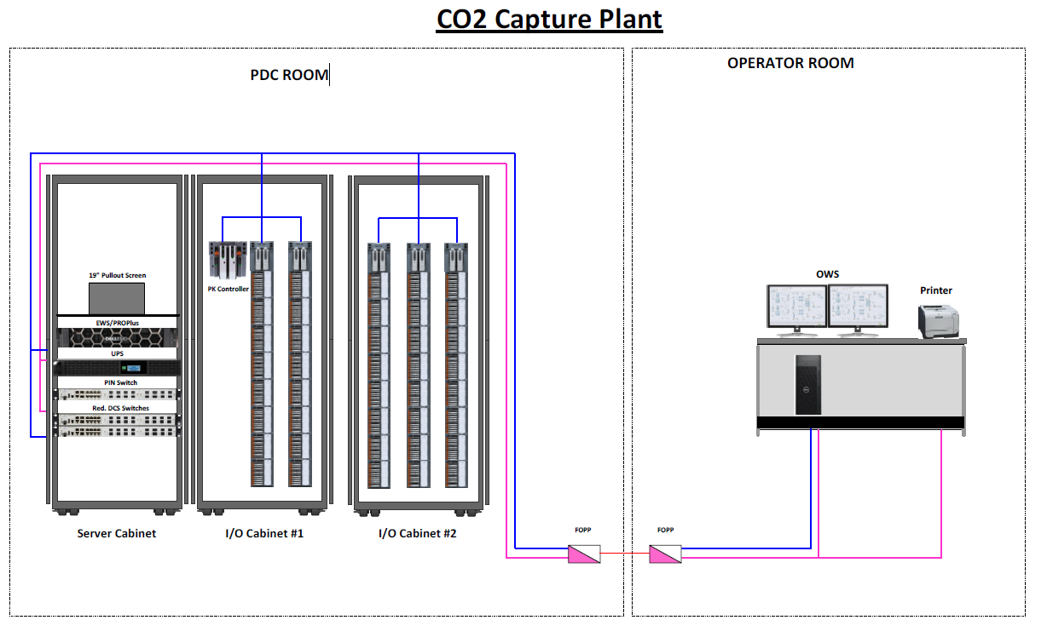
Final Architecture

